Slide 1
SAMSUNG SDS | AI USE CASE · DEVELOPMENT APPROVAL REQUEST
Self-Healing AI Agent
for UI Automation
Repairs broken UI selectors while the robot runs, on hardware we already own.
Confidential
SAMSUNG SDS
Notes:
One sentence framing: "Our robots break every time a website changes. This makes them fix themselves."
Point at the card on the right: the step was written against jobTitle, the release renamed it to positionTitle, and the robot found the new address, proved it on the page and carried on. Nothing in the script was edited.
If someone asks cost up front: "Fifty-four lakh, pays back in about twelve months - slide seven." Then move on.

Slide 2









SAMSUNG SDS | USE CASE · PROBLEM STATEMENT & SCOPE
Even a minor UI change can disrupt an entire automation.
A renamed field stops the robot, even though the field is still there.
ONE BROKEN SELECTOR, FIXED BY HAND
Failure
01
Triage
02
Repair
03
Redeploy
04
4-8 h to notice
30-45 min to diagnose
2-4 h to fix
2-4 h to land
Today: 1-2 days per broken selector With healing: ~6 seconds
SCOPE OF THE PROJECT
IN SCOPE
NOT IN PHASE 1
Web bots
Fleet-wide repair memory
Rewriting automations
CSS and XPath
Audit trail
Desktop, mainframe, Citrix
Runtime repair, inline
On-prem AI, no cloud
Deleted page elements
PAGE 02 / 07
Confidential
SAMSUNG SDS
Notes:
This slide is for whoever in the room has never written a selector. The analogy that lands: a selector is a postal address for a button. The building did not move; the street got renamed.
Walk the four cards left to right. The point is the handoffs, not any single number. The 4-12 hour detection window is the one that stings for ops: nobody is watching at two in the morning. These durations are typical, not measured on our estate - offer to instrument them.
Scope: web robots on Selenium or Playwright, both selector languages, repaired at runtime. Nobody is asked to rewrite an automation. Desktop, mainframe and Citrix UIs are not in phase 1, and a control a vendor deleted is reported as gone, never invented.

Slide 3






SAMSUNG SDS | HOW IT WORKS · HEAL AUTOMATION
The robot repairs itself in about six seconds.
When a selector breaks, healing steps in before the step fails.
01 INPUT
02 AUTOMATION
03 ANALYSIS
What it already knows
The healing pipeline
Decide, record, learn
Broken selector
Field description
Live page, ~900 elements
Last good fingerprint
1
Memory
instant
CONFIDENCE BAND
Reuse a proven fix.
REFUSE
REVIEW
APPLY
2
Pre-rank
0.3 s
42%
62%
900 elements down to 45.
Unproven: never auto-applied
Every decision audited
3
AI adjudicator
~5 s
Picks one, by index.
4
Bind + validate
0.2 s
Proves it on the page.
Index, not text. The AI decides the correct selector.
Fails open. Never stops a robot.
Policy decides, not the model.
PAGE 03 / 07
Confidential
SAMSUNG SDS
Notes:
This is the pivot. Read it left to right: what the robot already has, what the heal pipeline does with it, and how the result is judged.
Middle column: only step 3 needs an accelerator. Memory and pre-rank are free and deterministic, which is why this runs in six seconds and not sixty. The AI is handed a numbered list harvested from the live page and returns an index - it is structurally incapable of inventing a selector.
Right column: the model advises, a number decides. Below 0.42 we refuse and fail loudly - today's behaviour, so we lose nothing. A locator that was never seen working is never auto-applied at any confidence.
Do not use the model's name. It is not the point and it dates the deck.

Slide 4














SAMSUNG SDS | ARCHITECTURE · TECHNOLOGY STACK
One GPU host serves the whole robot fleet.
Robots keep the browser. One shared host runs the AI.
ROBOT HOST · NO GPU
HEALING HOST · ONE GPU
TECHNOLOGY STACK
ROBOT
Automation script
Repair store
Baseline store
Python · Selenium · Playwright
existing, unchanged
SQLite, proven fixes
last good fingerprints
HEALING SERVICE
find()
FastAPI · Uvicorn
fingerprints
only
Thin client
Healing service
Ranking engine
AI
bis.py, one file
FastAPI over HTTPS
8 signals, 900 to 45
llama.cpp · 4-bit GGUF · CUDA
an index,
not a selector
harvest, bind
DATA
SQLite · JSON
Browser
Confidence policy
AI adjudicator
Selenium or Playwright
apply / review / refuse
local LLM on the GPU
INFRASTRUCTURE
1 GPU server · internal HTTPS
PAGE 04 / 07
Confidential
SAMSUNG SDS
Notes:
This is the commercial slide disguised as an architecture slide. One GPU, many robots: "We buy the intelligence once, not once per robot."
Left box: the robot host keeps its existing script and gains one client file. No GPU, no model; rollout is a package install.
The arrows between the boxes are the security story: fingerprints of about 45 elements cross the wire - never the page, never a screenshot, never the values the robot is typing - and the service answers with an index, never a selector. The robot binds and proves it on the live page itself.
Right: every component is open source or open weights, on hardware we own. The repair store means a break one robot solves is free for every robot after it.

Slide 5
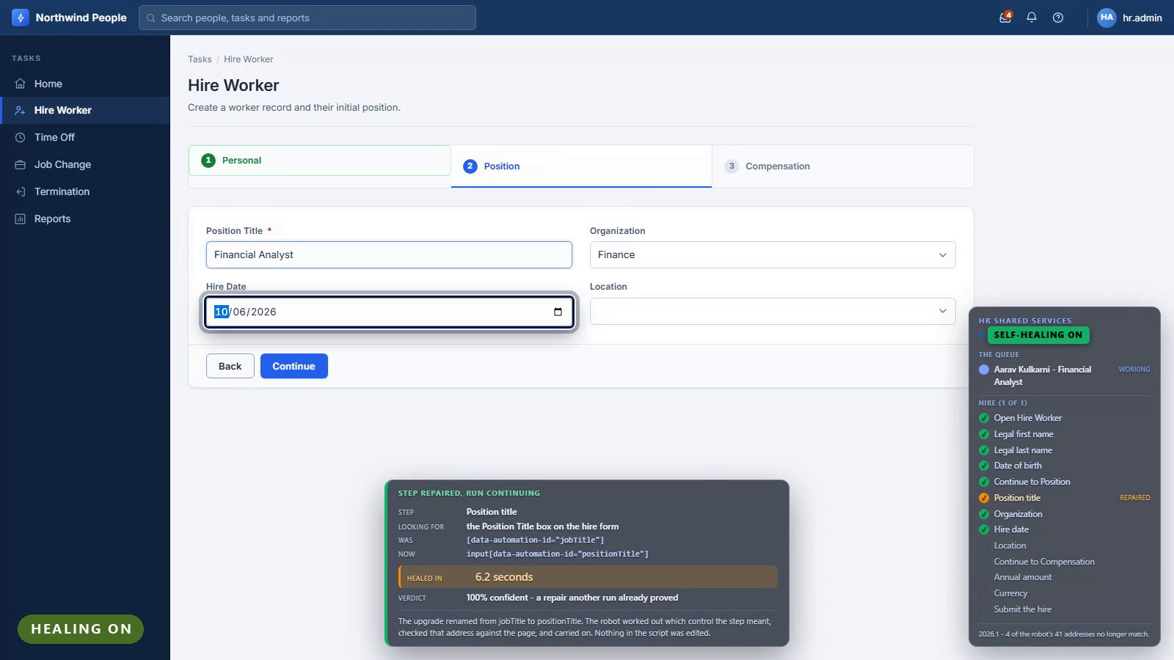
SAMSUNG SDS | UI / UX · DESIGN DEMO
What the operations team sees on screen.
Demo video. Click to play: before the release, healing off, healing on.
PAGE 05 / 07
Confidential
SAMSUNG SDS
Notes:
32-second video, three parts, all on the HR portal: on release 2025.1 the robot files a new hire unattended; on 2026.1 with healing off it stops at the renamed Position Title field; on 2026.1 with healing on, the card says what broke, what it found and how sure it is, and the hire completes.
Design rules: business language, not stack traces; the control being used is ringed on screen; the overlay never intercepts a click, so it observes the run rather than changing it.

Slide 6








SAMSUNG SDS | BENEFITS · BUSINESS & TECHNICAL
Business keeps running. Engineering stops chasing selectors.
BUSINESS BENEFITS
TECHNICAL BENEFITS
Overnight runs finish
No rewrite: add one file
Fix time: days to seconds
Works with Selenium & Playwright
~16,800 engineer-hours back a year
AI cannot invent a selector
Every decision auditable
One fix heals the whole fleet
Also: fails safe if the service is down · open weights on our hardware · nothing leaves the estate
PAGE 06 / 07
Confidential
SAMSUNG SDS
Notes:
Pick the column that matches your room and lead with it. Do not read all eight rows.
For operations: runs stop failing overnight for reasons nobody is awake to fix, and every decision the system made is written down.
For engineering: no rewrite - one client file beside an existing script - and it works with both drivers and both selector languages already in use. The AI picks an index; the page proves it.
The ₹87 L figure is the modelled saving from the ROI slide, not a measurement. The closing line is the strategic argument: the capability is ours, on our hardware, with no bill that grows as we succeed.

Slide 7
SAMSUNG SDS | COMMERCIAL CASE
Healing gives back ~16,800 engineer-hours a year.
6,400
THE MODEL · FIVE ASSUMPTIONS
selector breaks a year
500+
processes in scope
500 × 40 × 8% × 4 quarters
~40
locators per process
22,400
engineer-hours spent today
8%
break each quarter
6,400 × 3.5 h
16,800
3.5 h
engineer time per fix
engineer-hours saved a year
75%
healed without a person
22,400 h × 75% healed
PAGE 07 / 07
Confidential
SAMSUNG SDS
Notes:
Say the disclaimer before anyone asks. The engineering numbers are measured; these are a model. The dashed border is doing that job visually.
Invite challenge on the six assumptions directly: "If you think eight per cent is wrong, tell me your number and I will rerun this live." That invitation is what makes the slide credible.
The 85% heal rate is deliberately below our demo result. Do not quote 100% here.
Only the last line matters: ₹87 L a year recovered. Everything above is how we got there.

